Slide 1

Introduction to ML strategy
Why ML
Strategy?
deeplearning.ai

Slide 2
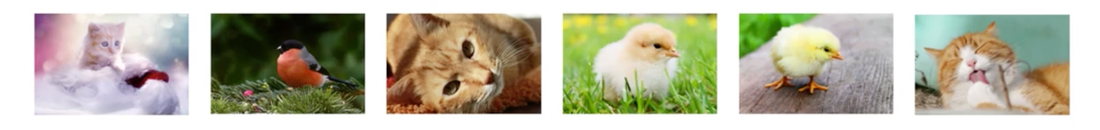

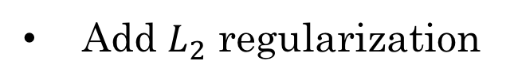
Motivating example
Ideas:
Collect more data
Try dropout
Collect more diverse training set
Add $L_{2}$ regularization
Train algorithm longer with gradient descent
Network architecture
Try Adam instead of gradient descent
Activation functions
Try bigger network
# hidden units
Try smaller network
…

Slide 3
Introduction to ML strategy
Orthogonalization
deeplearning.ai

Slide 4
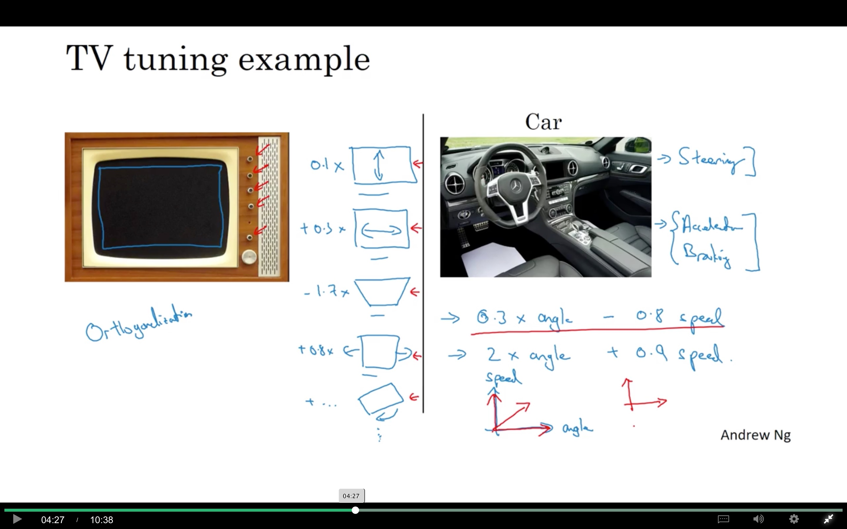

Slide 5
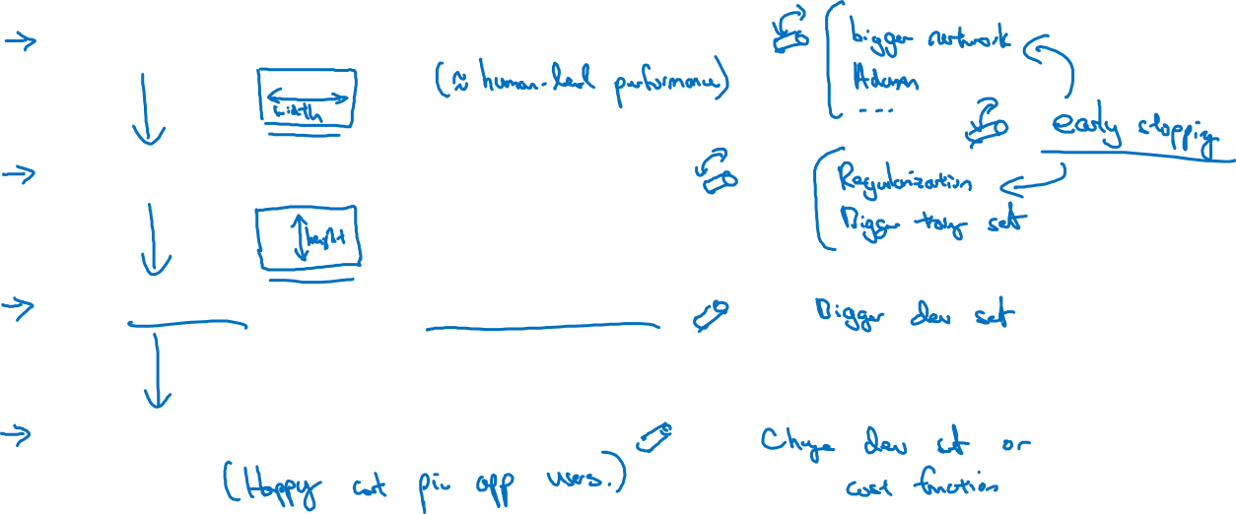
Chain of assumptions in ML
Fit training set well on cost function
Fit dev set well on cost function
Fit test set well on cost function
Performs well in real world

Slide 6
Setting up your goal
Single number
evaluation metric
deeplearning.ai

Slide 7

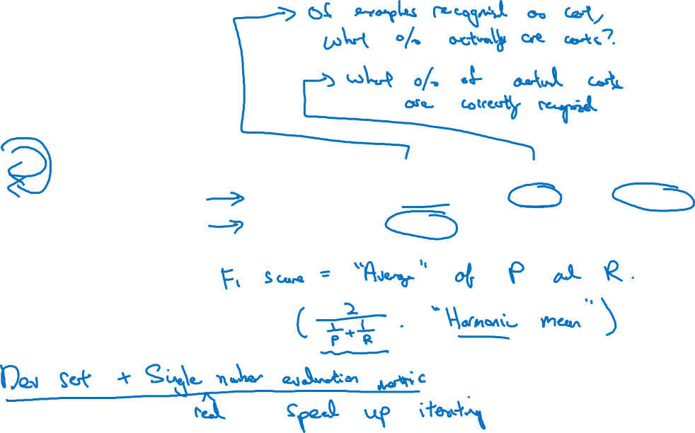
Using a single number evaluation metric
Idea
Classifier | Precision | Recall | F1 Score
A | 95% | 90% | 92.4%
B | 98% | 85% | 91.0%
Experiment
Code

Slide 8
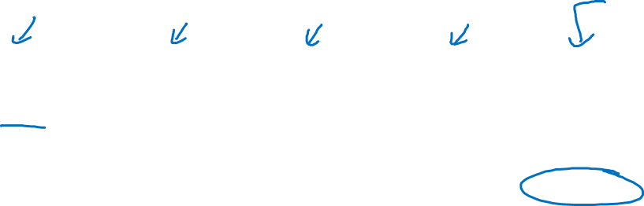
Another example
Algorithm | US | China | India | Other | Average
A | 3% | 7% | 5% | 9% | 6%
B | 5% | 6% | 5% | 10% | 6.5%
C | 2% | 3% | 4% | 5% | 3.5%
D | 5% | 8% | 7% | 2% | 5.25%
E | 4% | 5% | 2% | 4% | 3.75%
F | 7% | 11% | 8% | 12% | 9.5%

Slide 9
Setting up your goal
Satisficing and
optimizing metrics
deeplearning.ai

Slide 10
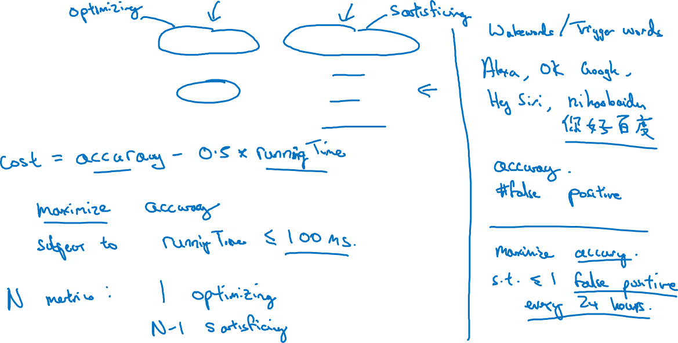
Another cat classification example
Classifier | Accuracy | Running time
A | 90% | 80ms
B | 92% | 95ms
C | 95% | 1,500ms

Slide 11
Setting up your goal
Train/dev/test
distributions
deeplearning.ai

Slide 12
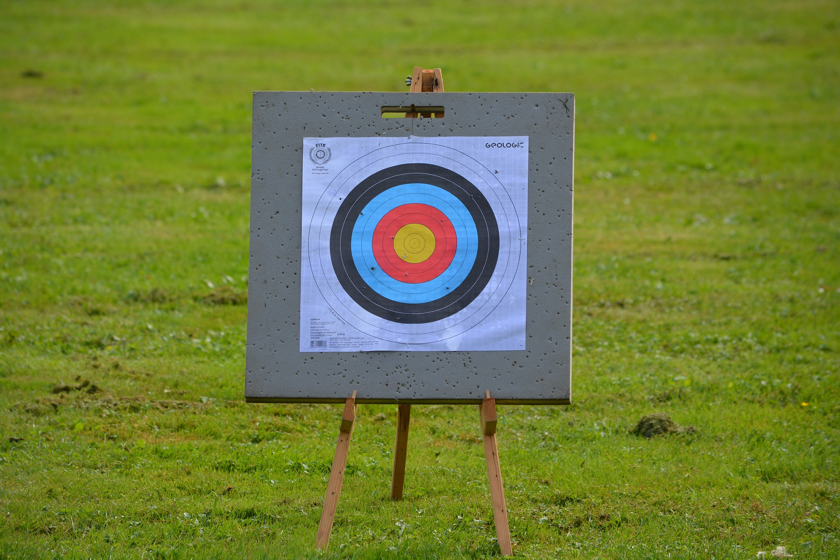
Cat classification dev/test sets
Regions:
US
UK
Other Europe
South America
India
China
Other Asia
Australia
Idea
Experiment
Code

Slide 13
True story (details changed)
Optimizing on dev set on loan approvals for medium income zip codes
Tested on low income zip codes

Slide 14
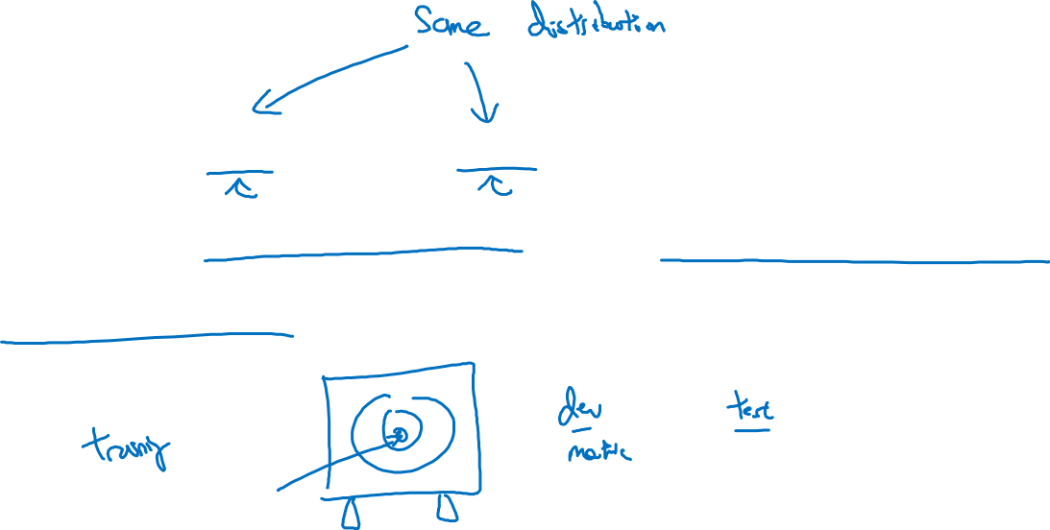
Guideline
Choose a dev set and test set to reflect data you
expect to get in the future and consider important
to do well on.

Slide 15
Setting up your goal
Size of dev
and test sets
deeplearning.ai

Slide 16
Old way of splitting data

Slide 17
Size of dev set
Set your dev set to be big enough to detect differences in
algorithm/models you’re trying out.

Slide 18
Size of test set
Set your test set to be big enough to give high confidence
in the overall performance of your system.

Slide 19
Setting up your goal
When to change
dev/test sets and
metrics
deeplearning.ai

Slide 20
Cat dataset examples
Metric: classification error
Algorithm A: 3% error
Algorithm B: 5% error

Slide 21
Orthogonalization for cat pictures: anti-porn
So far we’ve only discussed how to define a metric to evaluate classifiers.
2. Worry separately about how to do well on this metric.

Slide 22
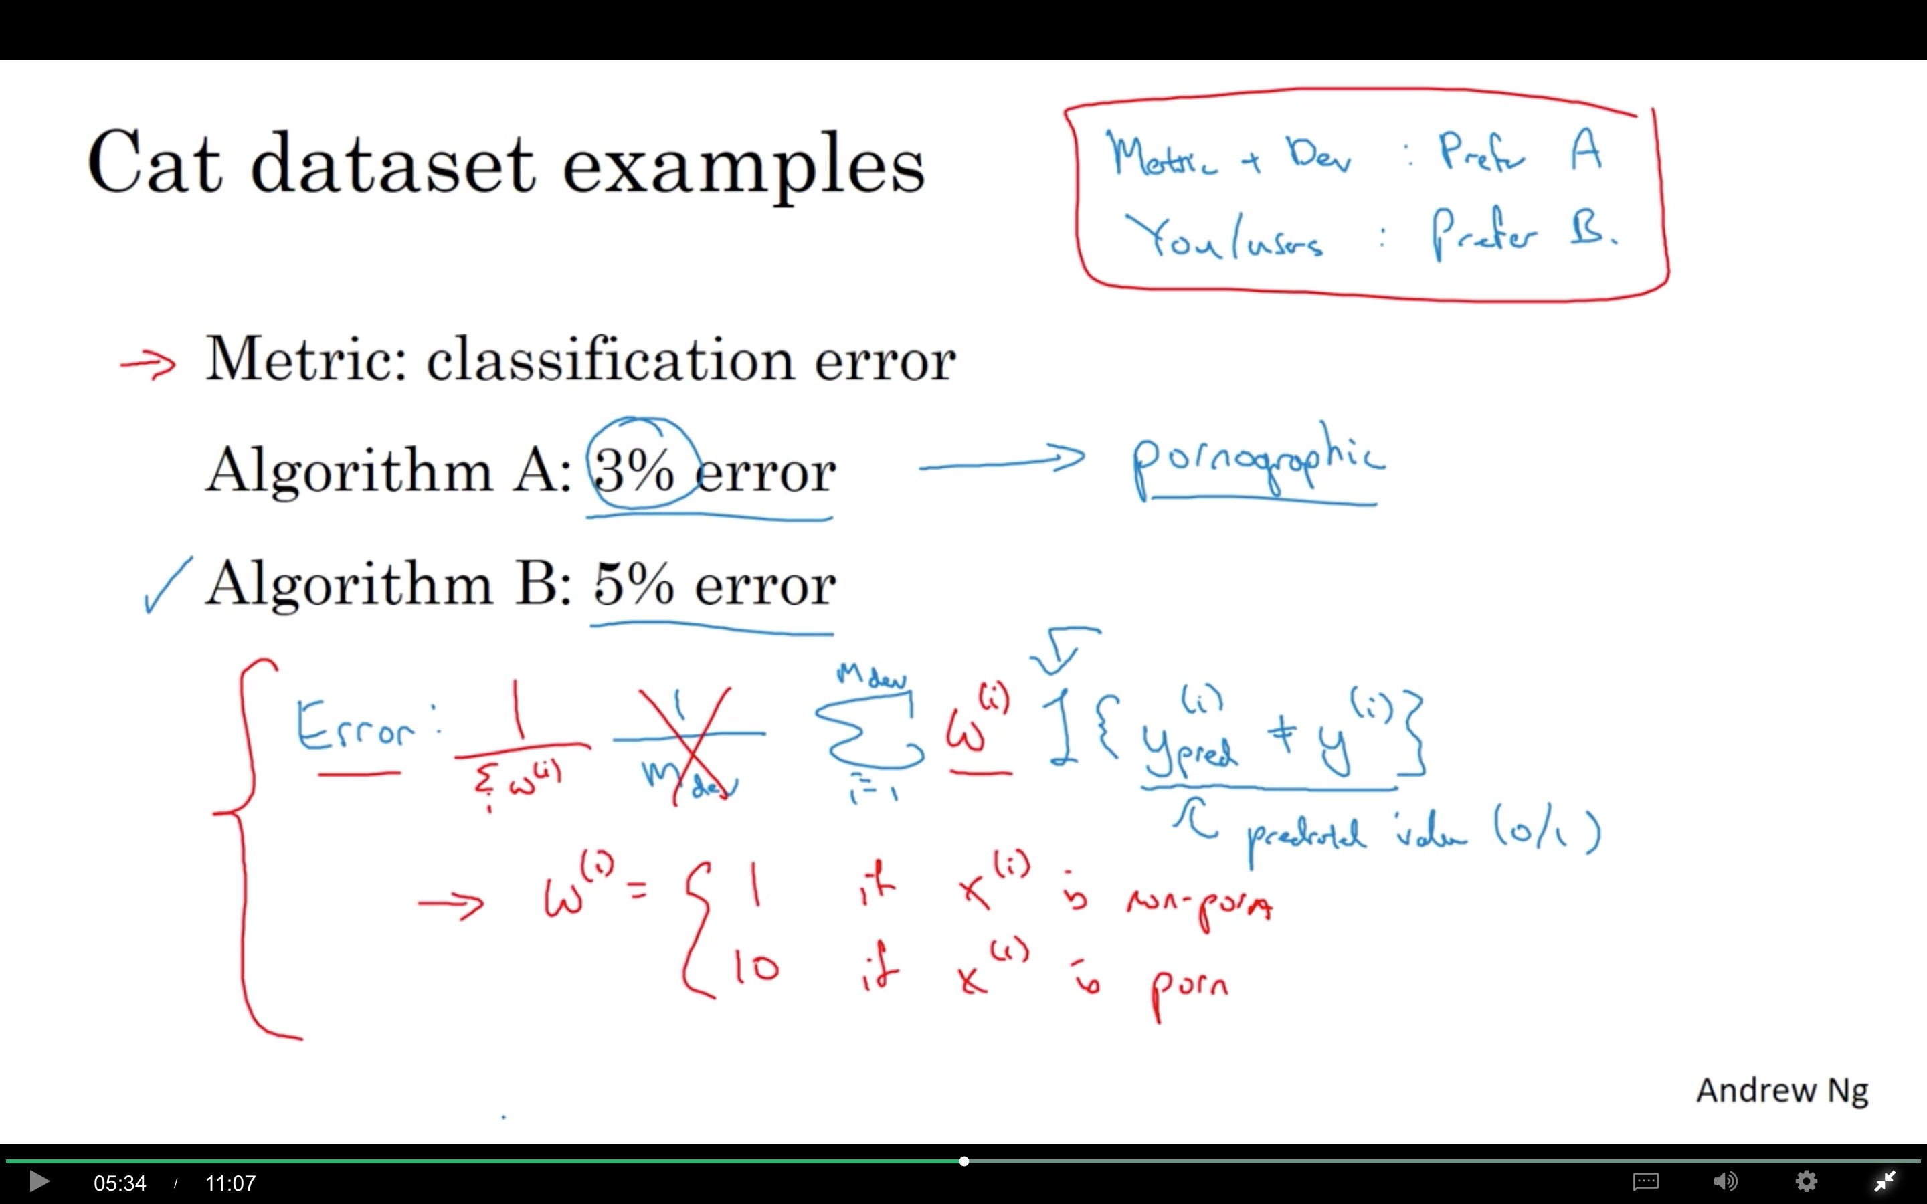

Slide 23
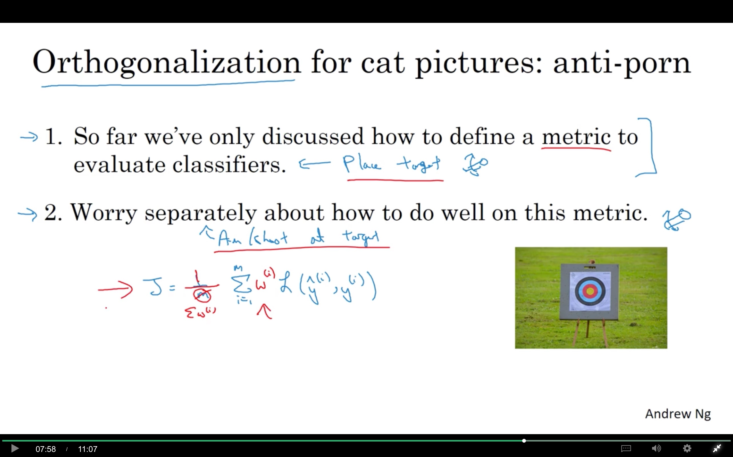

Slide 24
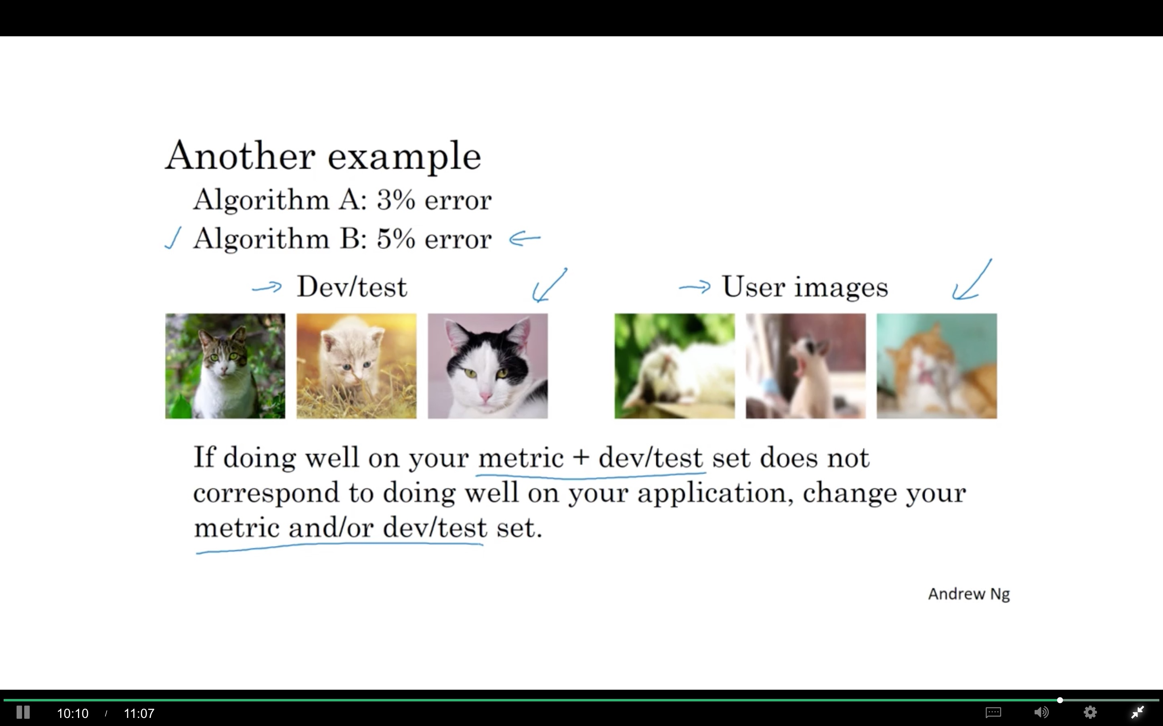

Slide 25
Comparing to human-level performance
Why human-level
performance?
deeplearning.ai

Slide 26
Comparing to human-level performance
accuracy
time

Slide 27
Why compare to human-level performance
Humans are quite good at a lot of tasks. So long as ML is worse than humans, you can:
Get labeled data from humans.
Gain insight from manual error analysis: Why did a person get this right?
Better analysis of bias/variance.

Slide 28
Comparing to human-level performance
Avoidable bias
deeplearning.ai

Slide 29
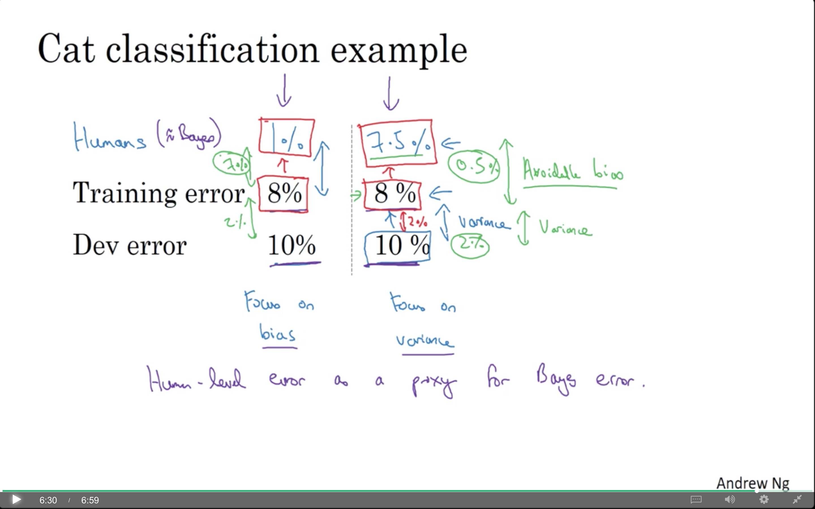

Slide 30
Comparing to human-level performance
Understanding human-level performance
deeplearning.ai

Slide 31
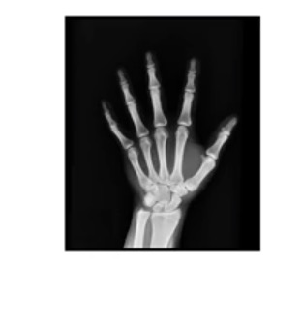
Human-level error as a proxy for Bayes error
Medical image classification example:
Suppose:
(a) Typical human ………………. 3 % error
(b) Typical doctor ………………... 1 % error
(c) Experienced doctor …………... 0.7 % error
(d) Team of experienced doctors .. 0.5 % error
What is “human-level” error?

Slide 32
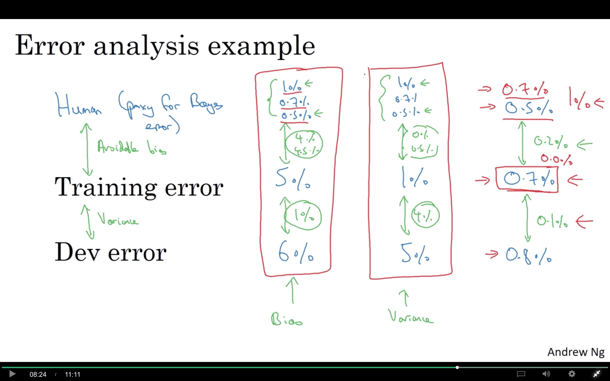

Slide 33
Summary of bias/variance with human-level performance
Human-level error
Training error
Dev error

Slide 34
Comparing to human-level performance
Surpassing human- level performance
deeplearning.ai

Slide 35
Surpassing human-level performance
Team of humans
One human
Training error
Dev error

Slide 36
Problems where ML significantly surpasses human-level performance
Online advertising
Product recommendations
Logistics (predicting transit time)
Loan approvals

Slide 37
Comparing to human-level performance
Improving your model
performance
deeplearning.ai

Slide 38
The two fundamental assumptions of supervised learning
1. You can fit the training set pretty well.
2. The training set performance generalizes pretty
well to the dev/test set.

Slide 39
Reducing (avoidable) bias and variance
Human-level
Train bigger model
Train longer/better optimization algorithms
Training error
NN architecture/hyperparameters search
More data
Dev error
Regularization
NN architecture/hyperparameters search

